Slide 1
MACHINE LEARNING ENGINEERING
Module 5

Slide 2
Building an ML pipeline for the real world: data collection, metrics, model building, model deployment, updating. Use cases from companies, Model interpretability and SHAP/feature importance.

Slide 3
Data Collection
Data collection is the phase where you gather the raw information your model will learn from.
In the real world, this doesn’t mean just “downloading a dataset.”
It’s about designing a strategy to ensure you get the right data, in the right format, with the right quality — and that the data continues to flow so your system stays relevant over time.

Slide 4
1. Define What Data You Need
Translate the ML problem into a precise data specification (features, labels, formats, minimum data size).
Identify potential data sources: databases, sensors, user interactions, APIs, logs, images, etc.
Evaluate each source for accessibility, latency, cost, privacy constraints, and reliability.
Create a data schema + metadata plan (timestamps, IDs, collection method, version) to maintain traceability and auditability.

Slide 5
2. Design the Data Collection Pro
Implement structured extraction jobs (ETL pipelines, API calls, logging systems) with validation checks like:
Schema validation
  All required columns exist
  Each column has correct datatype (e.g., temperature is a number, not “hot/cold”)
  No extra unexpected fields appear
  💡 It stops badly structured data from entering your system.
  Range/consistency checks: These checks make sure values are reasonable and internally consistent.
  Example checks:
  Temperature must be between –50°C and +60°C
  PM2.5 cannot be negative
  Humidity cannot be more than 100%
  Missing-value thresholds: You decide how much missing data is acceptable.
  Example:
  If only 1–2% values are missing → okay
  If 40% of humidity values are missing → something is wrong with the sensor
  If a whole column is empty → fail the job
  If too many values are missing, the system flags it instead of silently feeding broken data into your ML model.

Slide 6
For new data sources (e.g., app images, IoT sensors), define detailed instrumentation specs:Image resolution, format, lighting requirements
Sensor sampling rates, calibration procedures
User input prompts and constraints
Set up a system to quarantine or flag invalid or suspicious records instead of silently adding them to the dataset.
Plan storage strategy: Raw archive (immutable) for reproducibility
Processed store for training efficiency

Slide 7
3. Labeling & Annotation Strategy
Choose labeling approach depending on complexity:
  Weak supervision/heuristics for simple labels
  Crowdsourcing for high-volume tasks
  Domain experts for complex or safety-critical annotations
Provide annotators with:
  Clear labeling guidelines
  Examples and edge cases
  Calibration checks (e.g., inter-annotator agreement)
Use hybrid methods:
  Pre-label with heuristics → verify with humans
  Active learning to select the most useful samples for labeling

Slide 8
3. Labeling & Annotation Strategy
Choose labeling approach depending on complexity:
  Weak supervision/heuristics for simple labels
    Use simple rules to label data automatically.
    Example: If PM2.5 > 250 → label as "Severe."
  Crowdsourcing for high-volume tasks
    Many people label simple data that doesn’t need deep expertise.
    Example: "Is this leaf green or yellow?" Anyone can answer.
  Domain experts for complex or safety-critical annotations
    Use specialists when the label is complicated or important.
    Example: A plant pathologist deciding the exact crop disease.

Slide 9
Provide annotators with:
  Clear labeling guidelines
  Examples and edge cases: Examples of correct and incorrect labels
Calibration checks (e.g., inter-annotator agreement) : Sometimes two people label the same item differently. So you check their agreement (called inter-annotator agreement).
If people disagree too much:
  The rules need improvement
  The label is unclear
  Or more training is needed

Slide 10
Use hybrid methods:
  Pre-label with heuristics → verify with humans
    Instead of labeling everything manually:
    Use simple rules to pre-label data first
    (e.g., “If leaf is fully yellow → likely nutrient deficiency”)
    Then humans double-check, so you save time.
  Active learning to select the most useful samples for labeling

Slide 11
4. Governance, Monitoring & Continuous Feedback
Ensure compliance: capture consent, privacy metadata, anonymization, encryption.
  Get consent (people must agree to give their data).
  Store privacy-related information, like when consent was given.
  Use anonymization (remove names, phone numbers, anything personal).
  Use encryption so no one can read the data if it leaks.
Maintain audit logs for changes in collection code, labeling guidelines, and dataset versions
  This helps you understand what happened if the model suddenly stops working..

Slide 12
Continuously monitor incoming data for:
  Distribution shifts: Are the new values very different from before? (e.g., PM2.5 suddenly always high compared to last year)
  Sampling bias: Are you accidentally collecting more data from one group only? (e.g., leaf images only from one type of farm)
  Sudden changes in data patterns (e.g., new camera, UI changes, sensor errors)
    A new camera model → images look different
    A sensor breaks → produces strange values
    App update → changes how data is recorded

Slide 13
Metrics
Metrics help you measure model performance at every stage of the ML pipeline.
1. Classification Metrics (With Equations + Explanation)
Confusion Matrix Terms
TP: Model predicted positive & it was positive
TN: Model predicted negative & it was negative
FP: Model predicted positive but was wrong
FN: Model predicted negative but was wrong

Slide 14
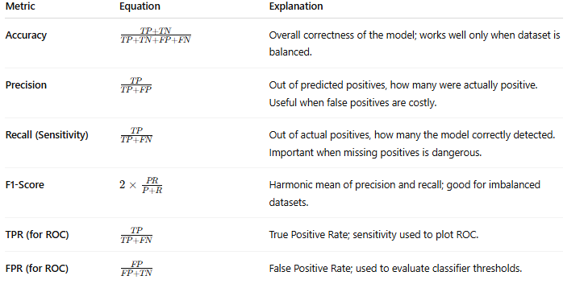


Slide 15
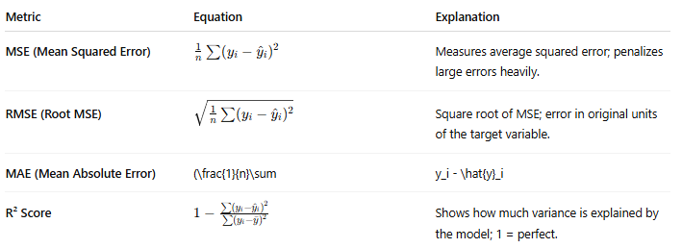
2. Regression Metrics (Equations + Explanation)
Given:
True value: yi
Predicted value: y^i
Total points: n

Slide 16
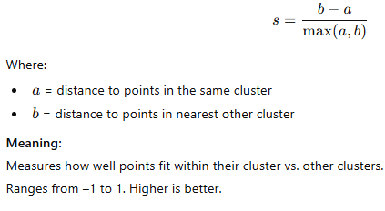
3. Clustering Metrics (Equations + Explanation)
A. Silhouette Score

Slide 17
Davies–Bouldin Index (DBI)
DBI is a clustering evaluation metric that tells you how good your clusters are.
You want clusters that are:
Compact (points close to each other inside the same cluster)
Well separated (clusters far from each other)
DBI combines these two goals into one score.
Lower DBI = better clustering.

Slide 18

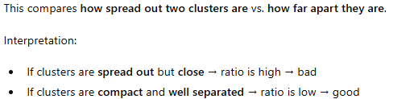
Si​: Intra-cluster scatter
Mij​: Distance between two cluster centers-This is the distance between the centroid of cluster i and centroid of cluster j.

Slide 19
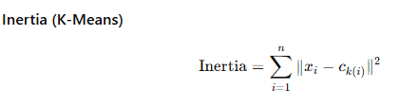
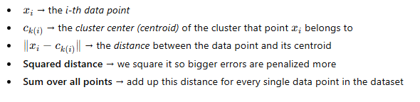
Low inertia = good clustering→ Points are close to their cluster centers
High inertia = poor clustering→ Points are far from their centers

Slide 20
Model Building (The Learning Phase)
This is the stage where your machine learning system actually learns from data.
What happens here?
You start with a clearly defined problem (classification, regression, clustering, forecasting, etc.).
Data is split into train, validation, and test sets.
You choose the right algorithm depending on the data and the goal (e.g., Random Forest, XGBoost, CNN, LSTM).
The model is trained—meaning it looks at patterns, adjusts parameters, and tries to reduce error.
Hyperparameters (learning rate, number of trees, depth, etc.) are tuned using Grid Search, Random Search, or Bayesian optimization.
You evaluate the trained model using metrics like accuracy, RMSE, F1-score, AUC, etc.
Finally, the best-performing model is selected and saved for deployment.

Slide 21
Model Deployment (Putting the Model into the Real World)
Once the model is trained and evaluated, it’s time to let real users or systems interact with it.
What happens here?
The final model is converted into a deployable format (pickle, joblib, SavedModel, ONNX).
  It makes the model reusable
  It allows other systems (APIs, mobile apps, cloud services) to load the model
  It ensures consistency between training and production.

Slide 22
It is integrated into an application:
  API endpoints using Flask/FastAPI
  Web apps
  Mobile apps
  Cloud services (AWS SageMaker, GCP AI Platform, Azure ML)
The model is hosted on a server or cloud environment.
Input data from real users flows into the model.
Predictions are returned instantly (or near real-time).

Slide 23
Model Updating (Keeping the Model Fresh & Accurate)
Once a model is deployed, the real world keeps changing. That’s where updating or retraining comes in.
What happens here?
The system continuously collects new data (real-time or periodically).
After deployment, every real-time interaction becomes a potential new training example.
  User inputs (text, images, numbers, sensor readings)
  System logs (requests, feedback)
  IoT / sensor streams
  Customer clicks, ratings, transactions
We need to Collect new data because
  Because:
  The world changes (concept drift)
  User patterns evolve
  New types of inputs start appearing
  The original training dataset becomes outdated

Slide 24
Performance is monitored using metrics like accuracy, drift score, latency, etc.
If performance drops (due to concept drift or data drift), the model is retrained:
  Incremental learning (update only with new data)
  Full retraining (retrain with old + new data)
  Model versioning (v1, v2, v3…)
Updated versions are tested and redeployed.

Slide 25
Incremental Learning
The model is partially updated:
Only new data (last few days/weeks) is used
Useful when data changes fast
Saves computation time
Works well for algorithms that support online learning:
  SGDClassifier
  Online Naive Bayes
  Reinforcement learning models
  Some neural networks with fine-tuning
  Example:
  If daily pollution data changes due to a new local event, you fine-tune the PM2.5 model with recent patterns.

Slide 26
Full retraining (retrain with old + new data)
Here, the whole model is rebuilt from scratch:
Combine historical dataset + new data
Shuffle and retrain entire pipeline
More stable and reliable
Removes accumulated bias
  Updating helps the model stay aligned with current data patterns instead of old, outdated ones.
Prevents "catastrophic forgetting“ — the model overwrites old knowledge.
  This is a common problem when you update a model only with new data.
  If a model learns from only new data and ignores older data, it slowly forgets how to predict older patterns.
This is used when:
There is major drift
Dataset is not too large
Accuracy matters more than speed
Your pipeline is stable and reproducible

Slide 27
Model versioning (v1, v2, v3…)
1. Assigning a unique identity to every model
Model versioning means giving each trained model a unique version (like v1, v2, 2025.11.18-rc1).
Whenever the model is retrained, tuned, or preprocessing changes, you create a new version.
This makes it easy to track which exact model is running and avoid confusion.

Slide 28
2. Storing full metadata for reproducibility
A version isn’t just a name — it also includes:
model artifact-the final trained model stored as a file(.h5 (Keras), .pt (PyTorch), .pkl (sklearn), .onnx)
dataset fingerprint - a unique signature (hash) that identifies the exact dataset used for training.
code commit hash - This is a Git commit ID — a long alphanumeric code that marks the exact version of the training code.Example: abc129f89124fd7b2d0e8341d8fefc3a0f3f1b2a
hyperparameters
training/validation metrics
environment details
With this, anyone can fully reproduce or audit how the model was created.

Slide 29
3. Supports safe deployment and rollback
With versioning, you can:
A/B test models
  compare new vs. old models
  quickly revert to a stable version if the new one performs poorly
  This prevents failures and keeps production reliable.
  An A/B test is a real-world experiment that compares two model versions to decide which one performs better in production.
4. Enables governance, auditing, and compliance
Versioning lets teams answer questions like:
“Which model generated this prediction?”
“What data/code produced this version?”
This is essential for regulated environments, debugging, and investigations.

Slide 30
5. Helps manage lifecycle & detect drift
Old versions can be archived or deprecated.
New versions can be retrained when data drifts.
Production data can be compared with the training dataset tied to each version to detect model decay.

